Slide 1





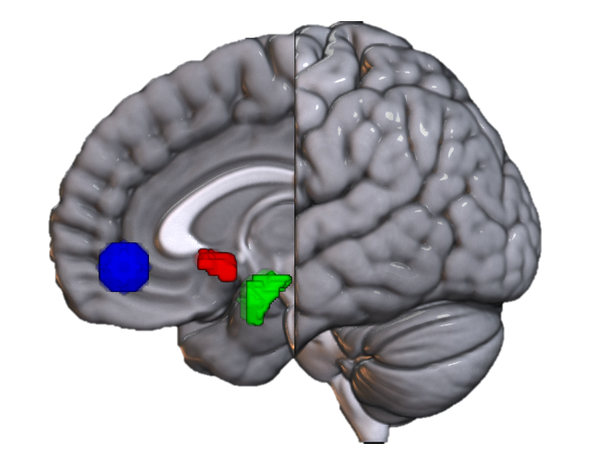



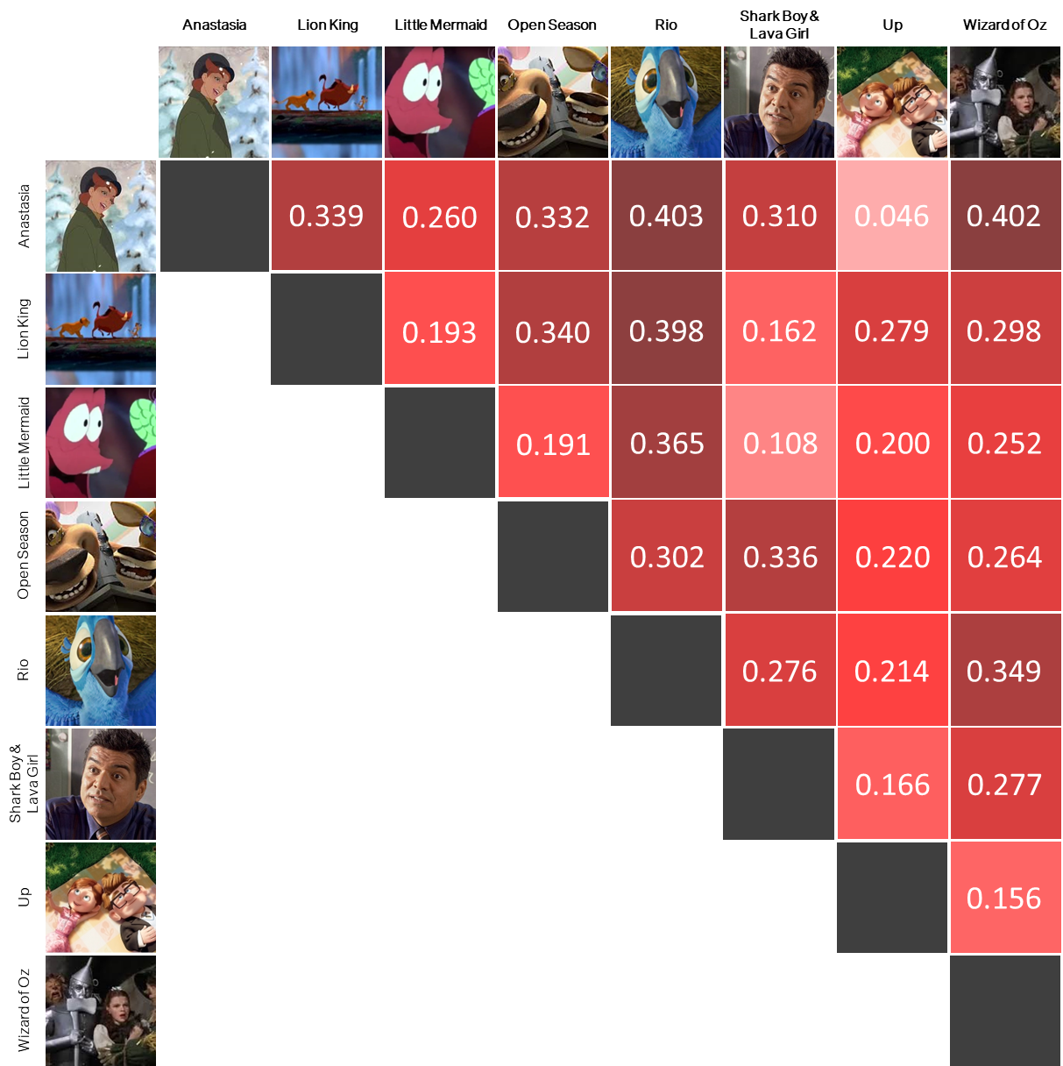
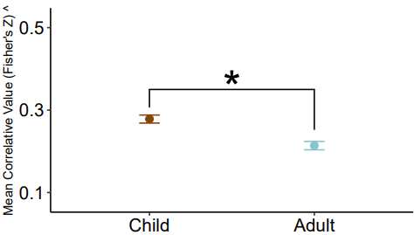

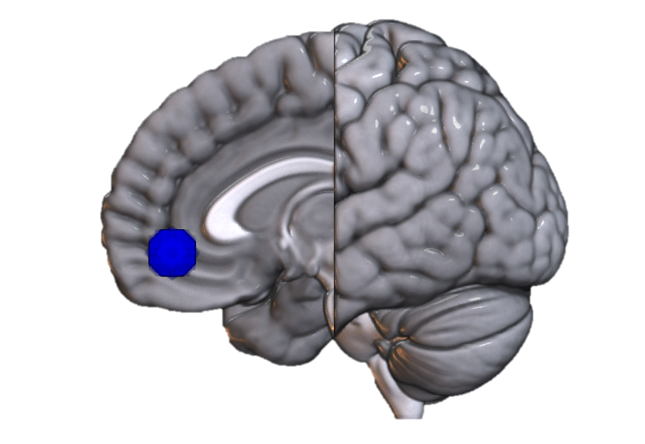

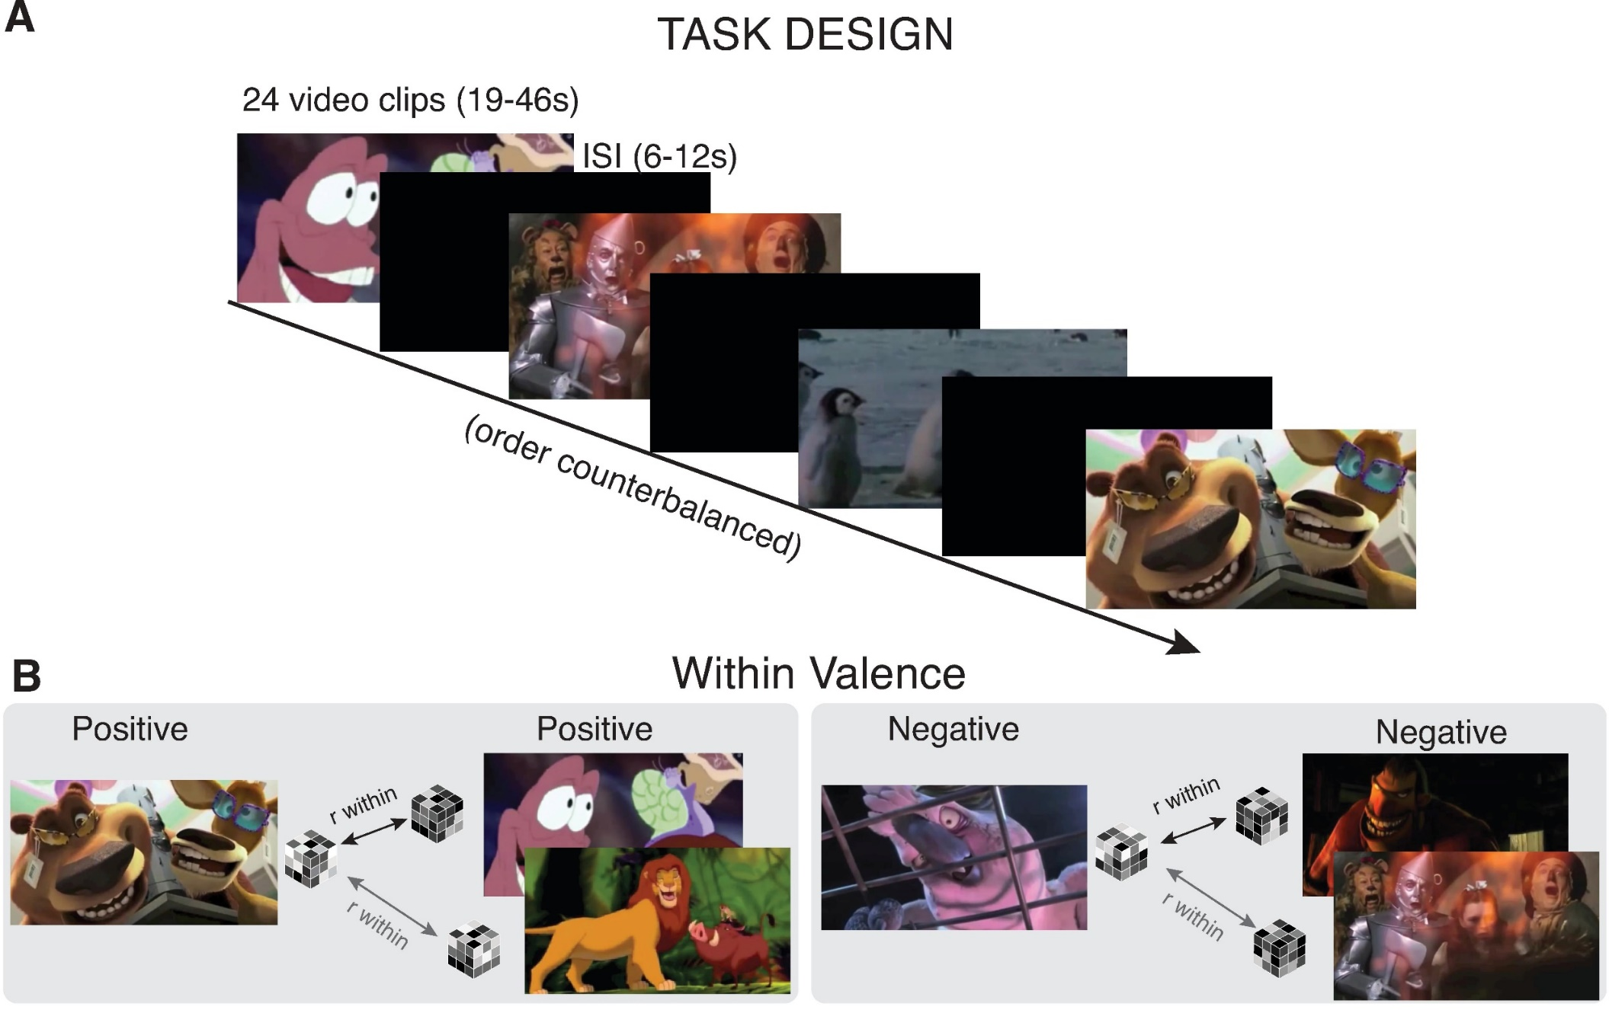


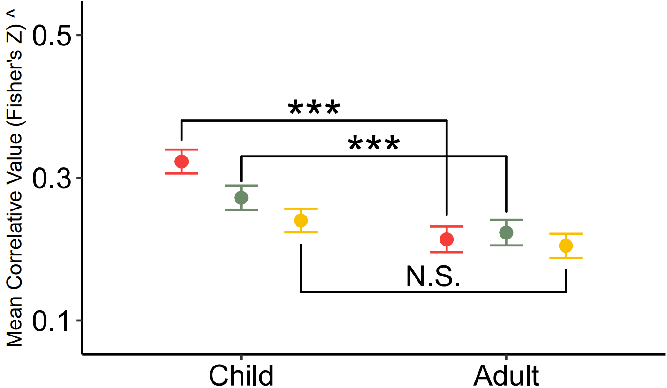
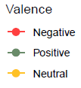
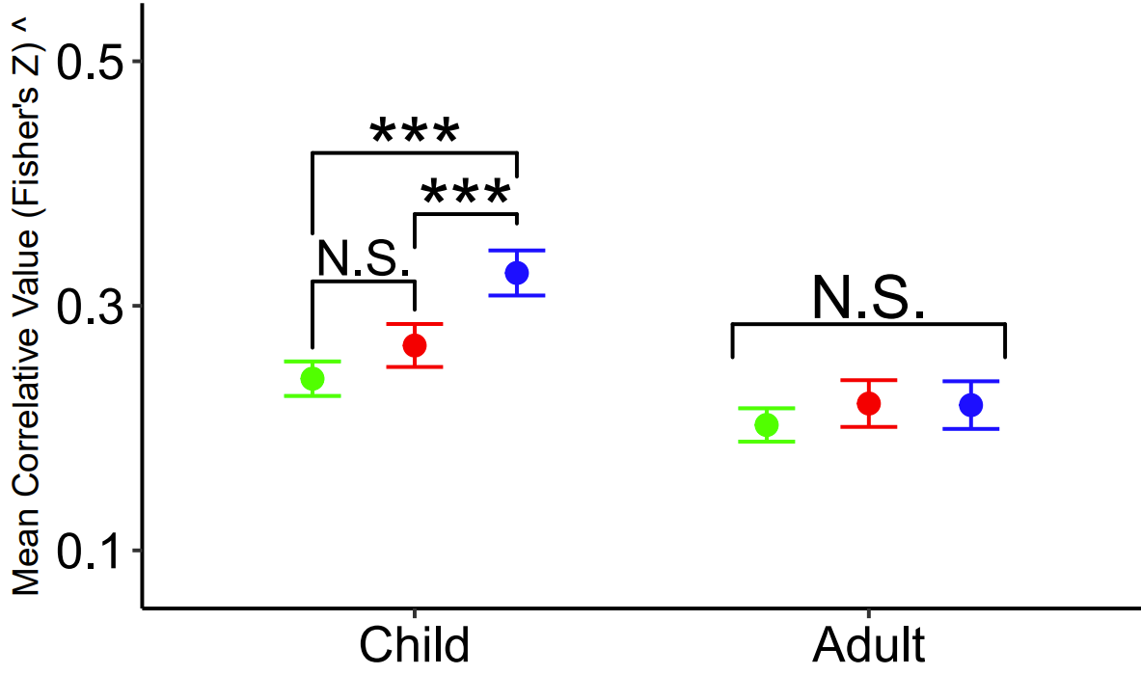
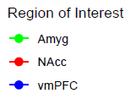


Do You Feel How I Feel?
Developmental Differences in Neural Representations of Affect
William Mitchell*, Lindsey Tepfer, Nicole Henninger, Susan Perlman, Vishnu Murty, Chelsea Helion
*Contact: Billy.Mitchell@temple.edu
Background
Hypotheses
Representational Similarity ⁴
Maturations in affective behavior correlate with network developments in key affective regions ¹⁻².
It’s unclear if these developmental differences are reflected within neural representations.
Naturalistic stimuli offer a more ecologically sound approach to exploring these developmental neural differences.
Children will generate more similar patterns than adults, suggesting less complexity.
Children will generate more similar valenced patterns than adults, suggesting less differentiation.
vmPFC patterns will be more similar than subcortical regions in children but not adults, suggesting greater recruitment in meaning-making tasks.
What is it? Watching film generates observable neural patterns. When stimuli with similar features elicit similar patterns, we learn about how those features are represented in the brain.
Why does it matter? Behaviors and cognitions reference representations. Understanding normative representatio-nal development can inform our underst-anding of non-normative outcomes.
Sample
Results
^ Note: Full range (-1.77 to 1.76) of Y-Axis restricted in visuals for comprehension sake. Error bars represent 95% confidence intervals.
> 0.05 = N.S. | < 0.05 = * | < 0.01 = ** | < 0.001 = ***
COMPLEXITY
A. Children demonstrated greater pattern similarity overall
Methods
Children and adults passively watched 24 film clips (8 Pos, 8 Neg, 8 Neut) during an fMRI scan ³. The neural patterns evoked within the vmPFC, NAcc, and Amyg were analyzed using an RSA approach.
Calculating RSA
We correlated neural response patterns within valence, within region, and within participant, resulting in the construction of a matrix for each unique ROI-valence-age group combination (18 in total). The average correlative value of a given matrix symbolizes how similarly neural patterns are in response to content of a given valence within a given region for a specific age group. Higher values sug-gest more similar patterns. Mean values and variances can be analyzed in traditional ANOVA to measure represe-ntational pattern differences.
DIFFERENTIATION
B. Children generated more similar patterns for positive and negative, but not neutral, stimuli
Regions of Interest
vmPFC
Amyg
NAcc
Discussion
MEANING-MAKING
Analyses
Results suggest neural affective repres-entations demonstrate predictable patt-erns in line with known behavioral devel-opmental differences.
Importantly, this research cannot com-ment upon the contents of represent-ations, does not include adolescents, and has a relatively small sample size.
This is the first application of a representational similarity approach on a developmental population using naturalistic stimuli to document affective differences.
C. Child vmPFCs demonstrated greater pattern similarity than subcortical regions; adults did not
Intravalence pattern similarity was calculated using the Spearman’s rank method. Correlative values were transformed using Fisher’s Z.
Differences in mean pattern similarity were assessed using a 3 (ROI) x 3 (Valence) x 2 (Age Group) Mixed Effects ANOVA with Bonferroni-adjusted post-hoc contrasts.
MANUSCRIPT
References
Nook, E. C., … & Somerville, L. H. (2017). Increasing verbal knowledge mediates development of multidimensional emotion representations. Nat. Human Behav., 1(12), 881–889.
Silvers, J. A., … & Ochsner, K. N. (2012). Age-related differences in emotional reactivity, regulation, and rejection sensitivity in adolescence. Emotion, 12(6), 1235–1247.
Karim, H. T., & Perlman, S. B. (2017). Neurodevelopmental maturation as a function of irritable temperament. Human Brain Map., 38(10), 5307–5321.
Popal, H. S., Wang, Y., & Olson, I. R. (2019). A Guide To Representational Similarity Analysis for Social Neuroscience. Social Cog. Affect. Neurosci., 14(11),1243–1253.

